Slide 1
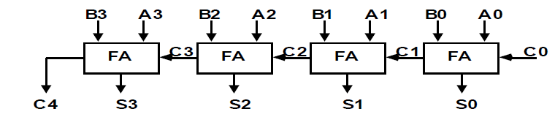
Binary Adder/Ripple Carry Adder/Parallel Adder
Digital circuit that forms the arithmetic sum of 2 bits and the previous carry is called FULL ADDER.
Digital circuit that generates the arithmetic sum of 2 binary numbers of any lengths is called BINARY ADDER.
The binary adder is constructed with full-adder circuits connected in serial order, with the output carry from one full-adder connected to the input carry of the next full-adder
Figure shows the interconnections of four full-adders (FA) to provide a 4-bit binary adder.

Slide 2
Binary Adder
The augends bits of A and the addend bits of B are designated by subscript numbers from right to left, with subscript 0 denoting the low-order bit.
The carries are connected in a chain through the full-adders. The input carry to the binary adder is Co and the output carry is C4. The S outputs of the full-adders generate the required sum bits.
An n-bit binary adder requires n full-adders.
The output carry from each full-adder is connected to the input carry of the next-higher order full adder.

Slide 3
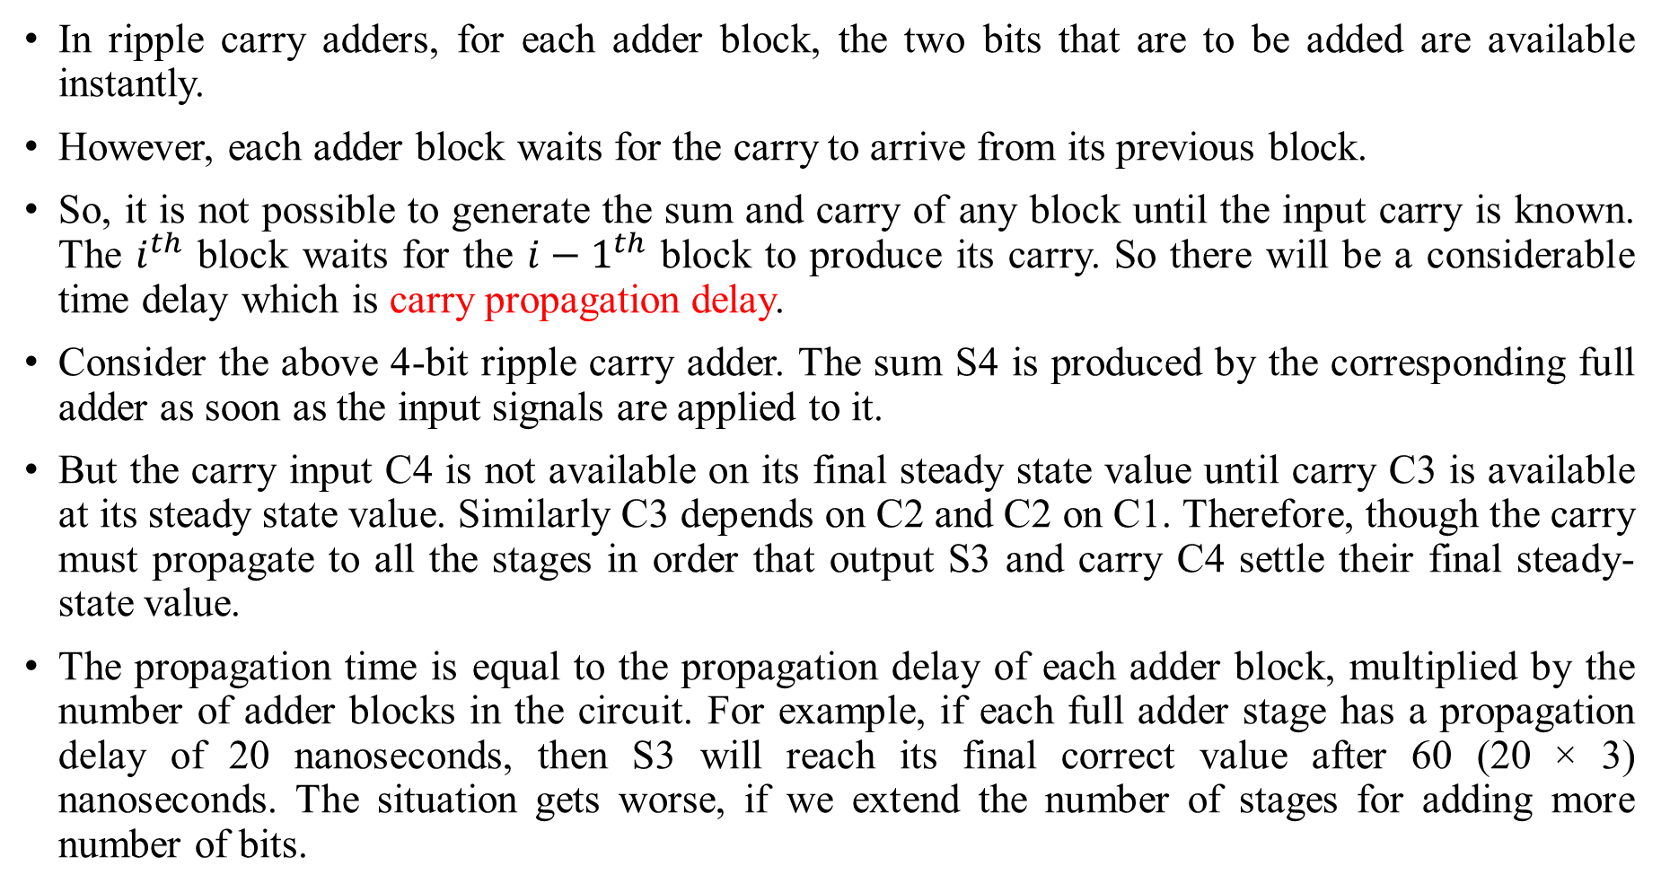
Why Carry Look-Ahead Adder is used?
In ripple carry adders, for each adder block, the two bits that are to be added are available instantly.
However, each adder block waits for the carry to arrive from its previous block.
So, it is not possible to generate the sum and carry of any block until the input carry is known. The $i^{th}$ block waits for the $i−1^{th}$ block to produce its carry. So there will be a considerable time delay which is carry propagation delay.
Consider the above 4-bit ripple carry adder. The sum S4 is produced by the corresponding full adder as soon as the input signals are applied to it.
But the carry input C4 is not available on its final steady state value until carry C3 is available at its steady state value. Similarly C3 depends on C2 and C2 on C1. Therefore, though the carry must propagate to all the stages in order that output S3 and carry C4 settle their final steady-state value.
The propagation time is equal to the propagation delay of each adder block, multiplied by the number of adder blocks in the circuit. For example, if each full adder stage has a propagation delay of 20 nanoseconds, then S3 will reach its final correct value after 60 (20 × 3) nanoseconds. The situation gets worse, if we extend the number of stages for adding more number of bits.

Slide 4
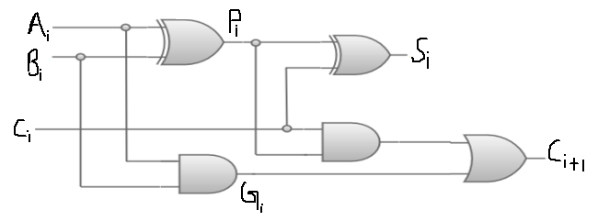
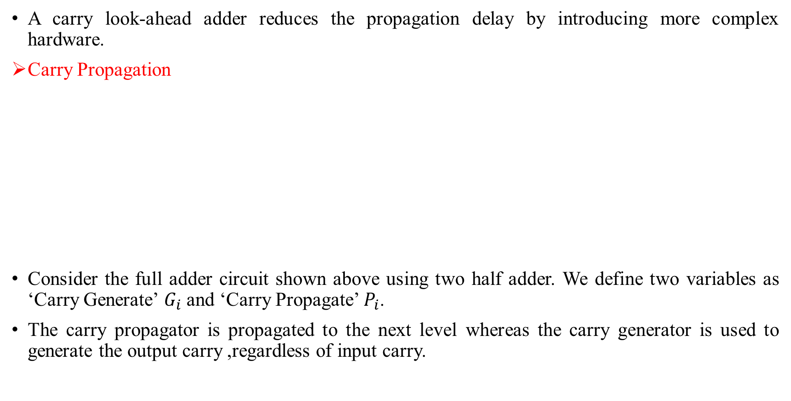
Carry Look-Ahead Adder
A carry look-ahead adder reduces the propagation delay by introducing more complex hardware.
Carry Propagation
Consider the full adder circuit shown above using two half adder. We define two variables as ‘Carry Generate’ $G_{i}$ and ‘Carry Propagate’ $P_{i}$.
The carry propagator is propagated to the next level whereas the carry generator is used to generate the output carry ,regardless of input carry.

Slide 5
Carry Look-Ahead Adder Cont..
The corresponding Boolean expressions are given here to construct a carry look-ahead adder. In the carry-look-ahead circuit we need to generate the two signals Carry Propagator (P) and Carry Generator(G),So we the Boolean expression can be defined as
Pi = Ai ⊕ Bi
Gi = Ai · Bi
The output sum and carry can be expressed as
Si = Pi ⊕ Ci
Ci+1 = Gi + ( Pi · Ci)
Having these we could design the circuit. We can now write the Boolean function for the carry output of each stage and substitute for each Ci (i=0) its value from the previous equations,
C0-Input Carry
C1 = G0 + P0 · C0
C2 = G1 + P1 · C1 = G1 + P1 · G0 + P1 · P0 · C0
C3 = G2 + P2 · C2 = G2 +P2 · G1 + P2 · P1 · G0 + P2 · P1 · P0 · C0
C4 = G3 + P3 · C3 = G3 +P3 · G2 +P3 · P2 · G1 + P3 · P2 · P1 · G0 + P3 · P2 · P1 · P0 · C0

Slide 6
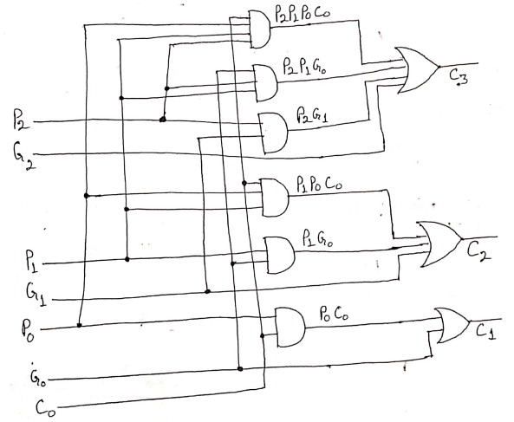
From the above Boolean equations we can observe that C4 does not have to wait for C3 and C2 to propagate but actually C4 is propagated at the same time as C3 and C2.
Since the Boolean expression for each carry output is the sum of products so these can be implemented with one level of AND gates followed by an OR gate.
Logic Gate for Look-ahead Carry

Slide 7
Block Diagram of 4-Bit Look Ahead-Carry adder
Carries are propagated through the carry look-ahead generator and applied as I/P’s to the second XOR gate.
All output carries are generated after a delay through two level of gates. Thus outputs S1 through S3 have equal propagation delay times.
This circuit can add in less time because C3 does not have to wait for C2 and C1 to propagate

Slide 8
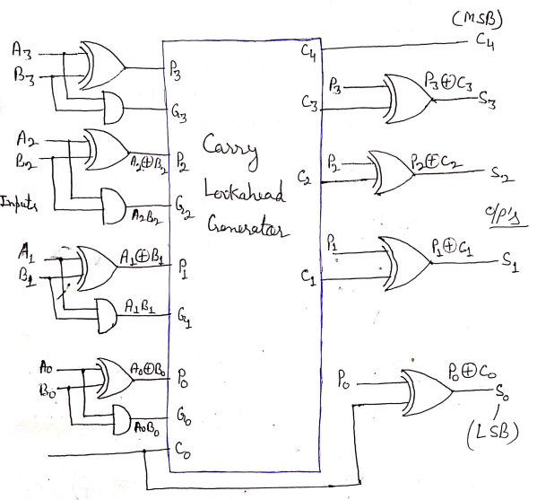
4-bit carry look-ahead adder block diagram

Slide 9
Binary Adder –Subtractor
The subtraction of binary number can be done most conveniently by means of complement.
The subtraction A-B can be done by taking the 2’s complement of B and adding it to A. The 2’s complement can be obtained by taking the 1’s complement and adding one to the lest significant pair of bits. The 1’s complement can be implemented with the inverters and a one can be added to the sum through the input carry.
The addition and subtraction operation can be combined into one common circuit by including and exclusive- OR gate with each full adder.
The addition and subtraction operations can be combined into one common circuit by including an exclusive-OR gate with each full-adder. A 4-bit adder-subtractor circuit is shown in the below figure.

Slide 10
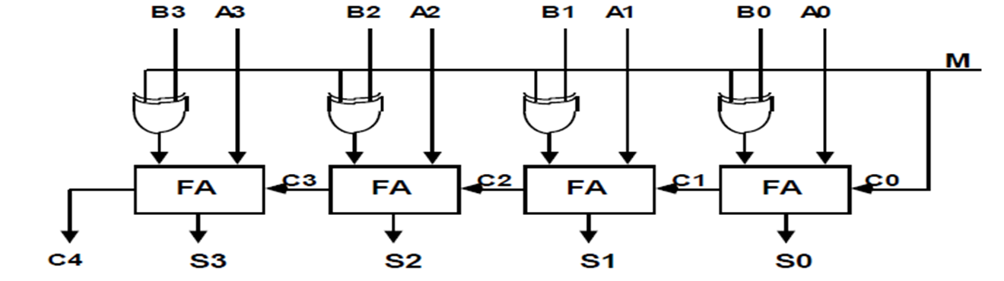
Binary Adder –Subtractor
The mode input M controls the operation. When M = 0 the circuit is an adder and when M = 1 the circuit becomes a subtractor.
Each exclusive-OR gate receives input M and one of the inputs of B.
When M = 0, we have B XOR 0 = B. The full-adders receive the value of B, the input carry is 0, and the circuit performs A plus B.
When M = 1, we have B XOR 1 = B' and Co = 1.
The B inputs are all complemented and a 1 is added through the input carry.
The circuit performs the operation A plus the 2's complement of B.

